Slide 1
Solar Generation System
Team 19: Chris Goodrich, Damon Stubbs, Drew Wassenaar,
Kenny Nguyen, Taylor Mullen
Advisor/Client: Professor Ajjarapu
Website: http://sddec18-19.sd.ece.iastate.edu

Slide 2
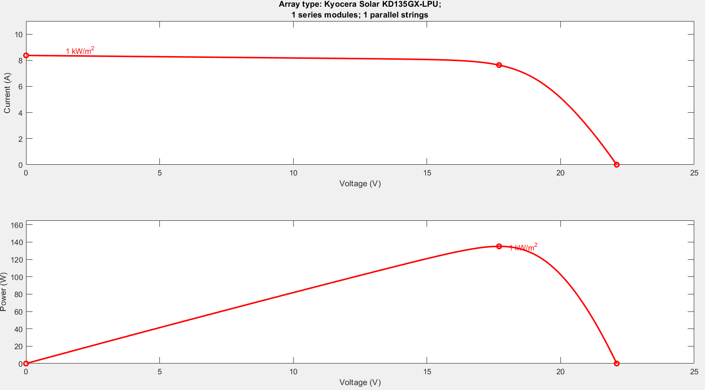
Introduction
EE 452 Solar Power Lab
Use different resistive loads directly with Solar Panels
Use same loads with MPPT and Solar Panels

Slide 3
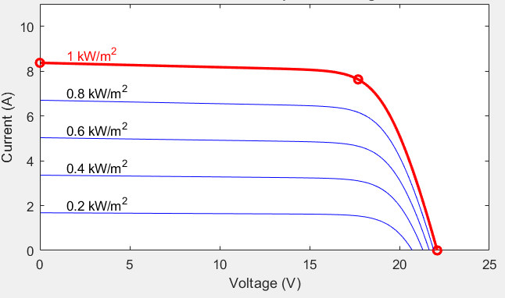
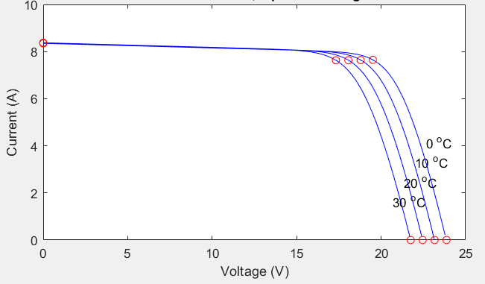
I-V CHARACTERISTICS
Varying Irradiance Varying Temperature

Slide 4
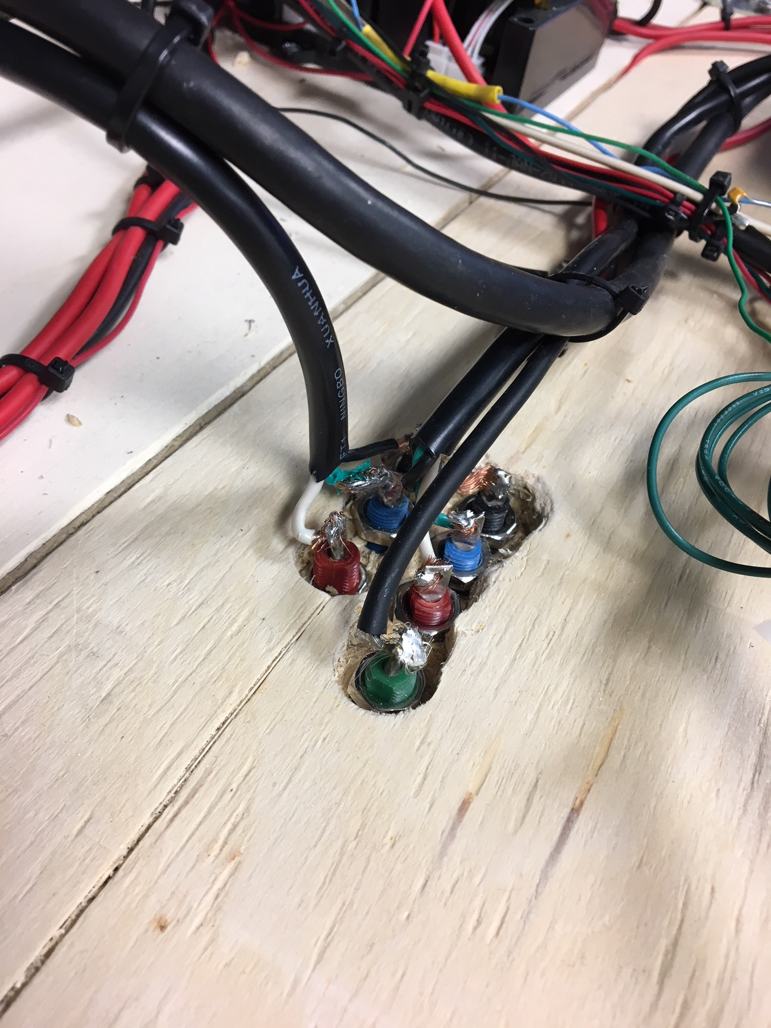
Problem Statement
Current Lab is unstable and unsafe
DC load is insufficient to fully display I-V characteristics of Solar Panel and MPPT
Solar Panels are in the shade by mid afternoon

Slide 5
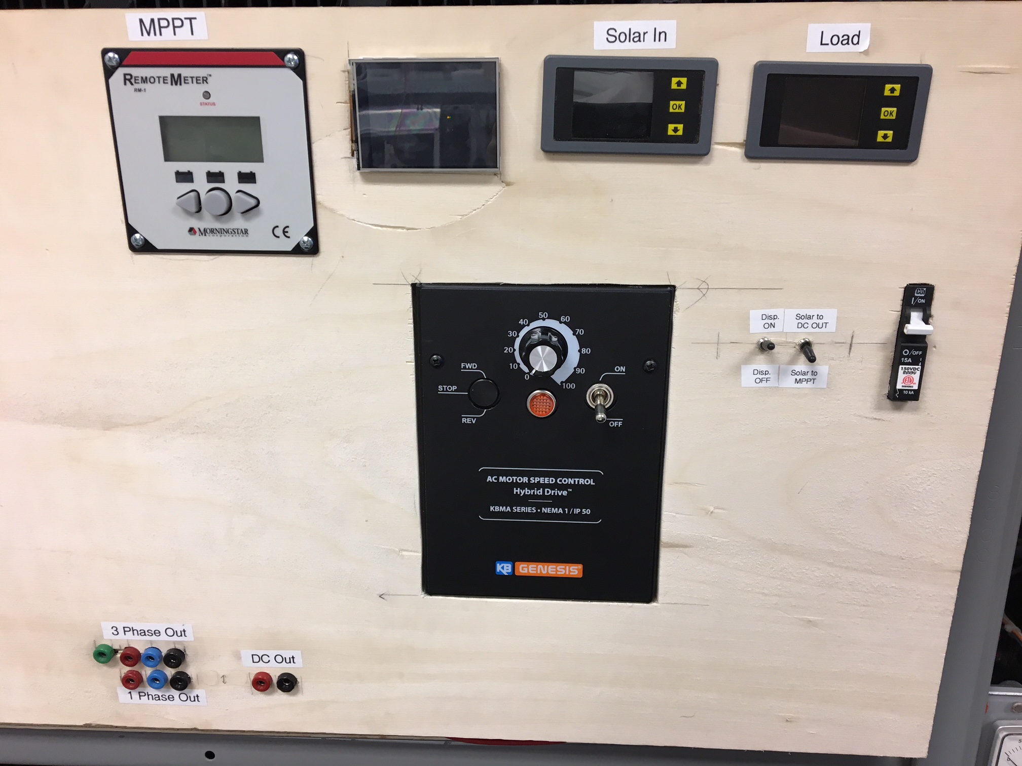
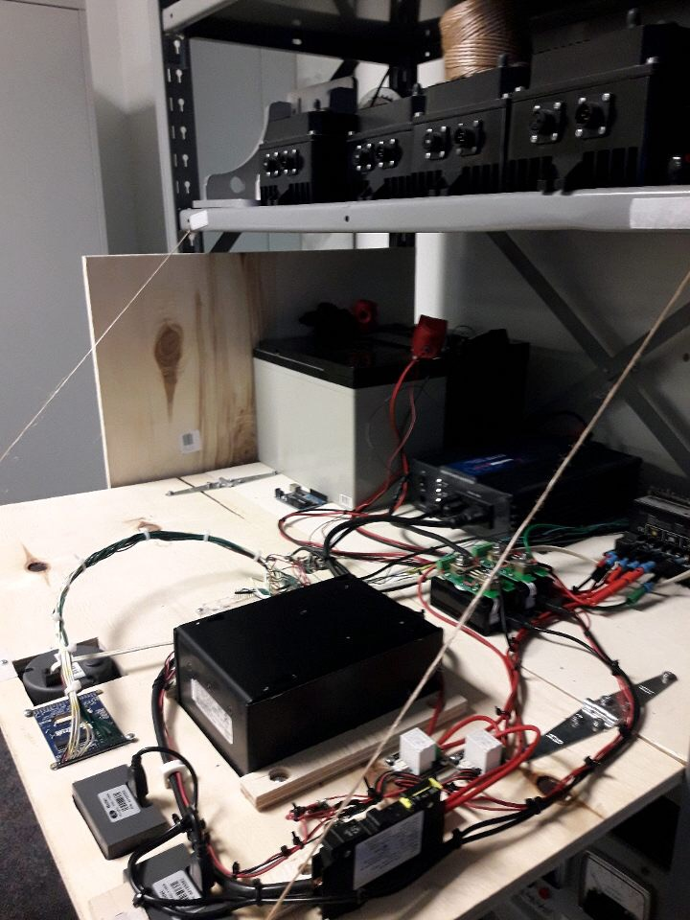
Problems continued

Slide 6
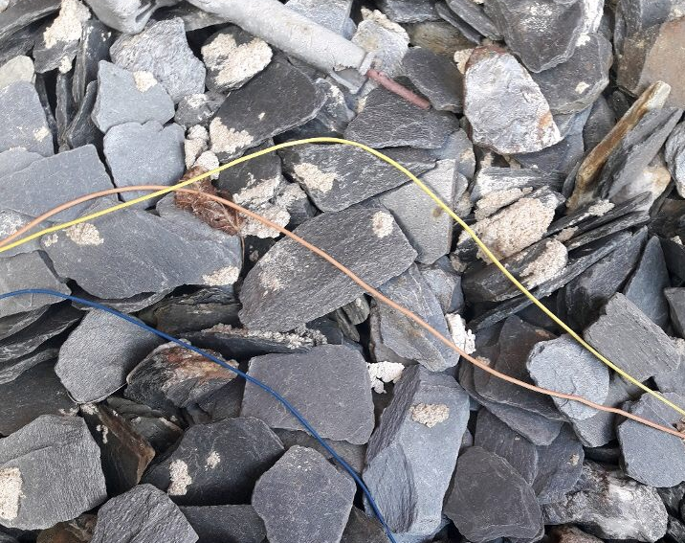
Constraints
Weather – Outside all year long
Last without use for up to a year
Survive use by students

Slide 7
Resistor bank design Functional Requirements
Load flexible enough to plot I-V characteristics of Solar Panels
Must withstand high power at load
Displays showing accurate internal voltages and currents

Slide 8
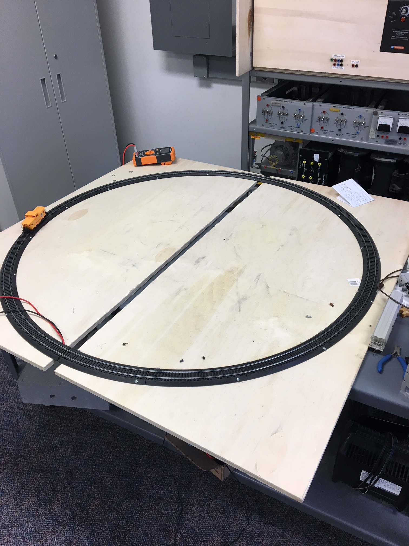
Non-Functional Requirements
Must be delivered in lab format
Lab must be able to be finished in well under 3 hours
Must fit in designated area
2x2x3 feet for circuitry
Inside existing model train (3 foot diameter) for load
Make circuitry safe and stable

Slide 9
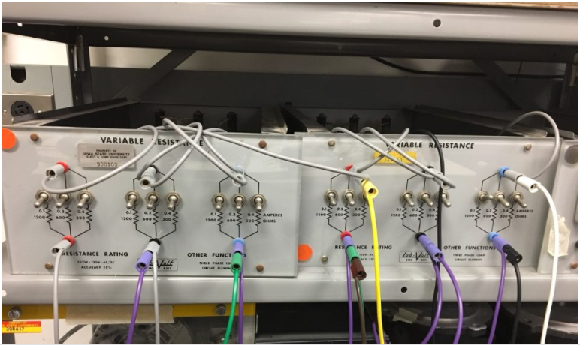
Prototype
Prototype test lab setup within Simulink
Housing with various resistive loads to connect to

Slide 10
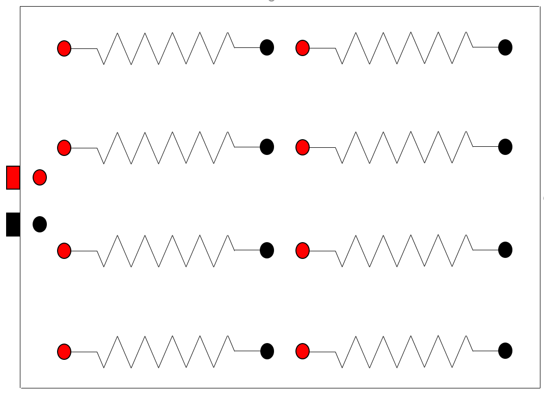
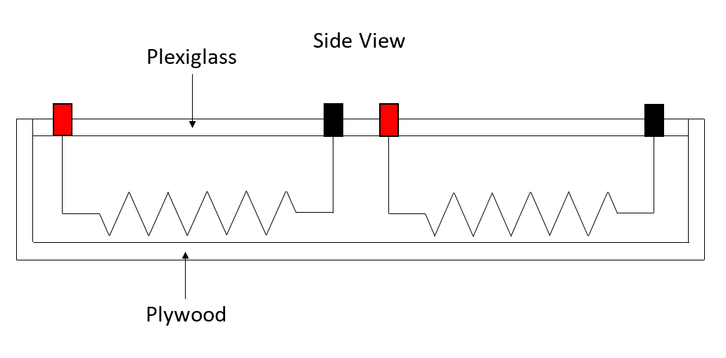
Design iterations concept sketch
Top View

Slide 11
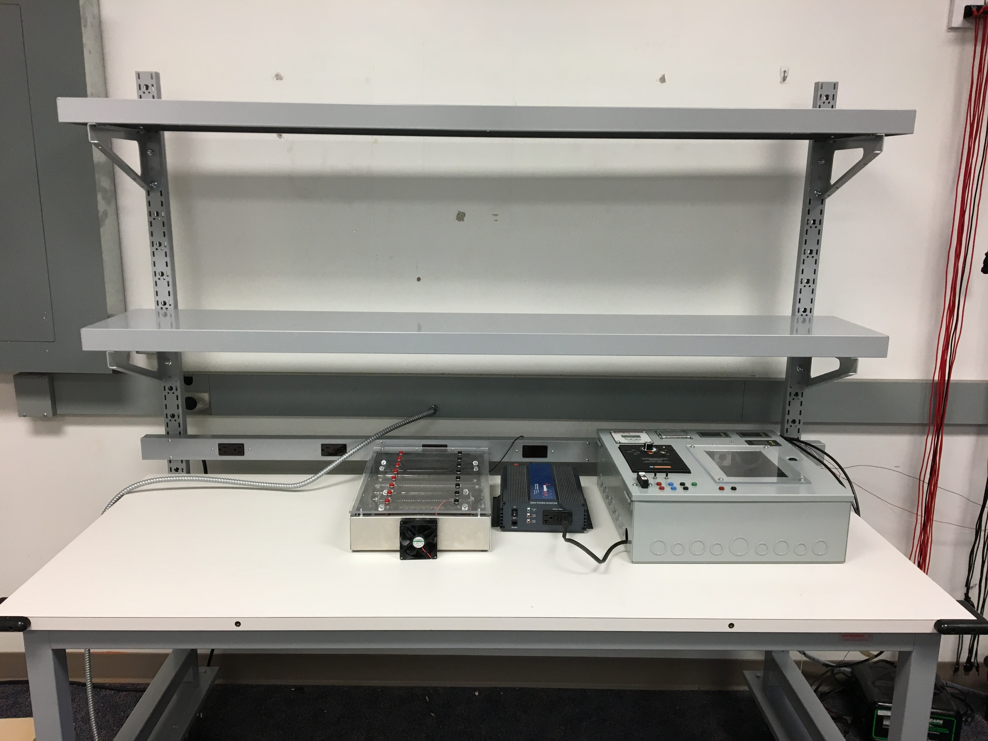
Design iterations
Metal Enclosure
Resistor Layout
Fan
Cool resistors
Workbench
Room for expansion

Slide 12
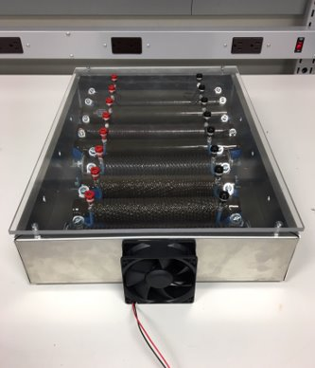
Resistor Bank Design
Aluminum Enclosure 17" x 2"
Resistors: 8" x 2" and 10" x 2"
Resistance Needed: 0.5Ω - 200Ω
Current Power Rating: 300 W
Resistor Values: 1, 2, 5, 16, 25, 100, 150, 200 Ω
Provides Max Resistance: 499 Ω
Provides Min Resistance: 0.54 Ω

Slide 13
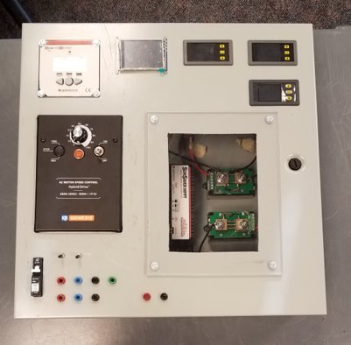
Circuit Safety Design
Fully Enclosed Circuit Container
Locking Access Panel
Wire Management, and High Voltage Isolation
Circuit Breaker to Disconnect Solar Panels
Wire Insulation
Grounding the Ground Rail

Slide 14
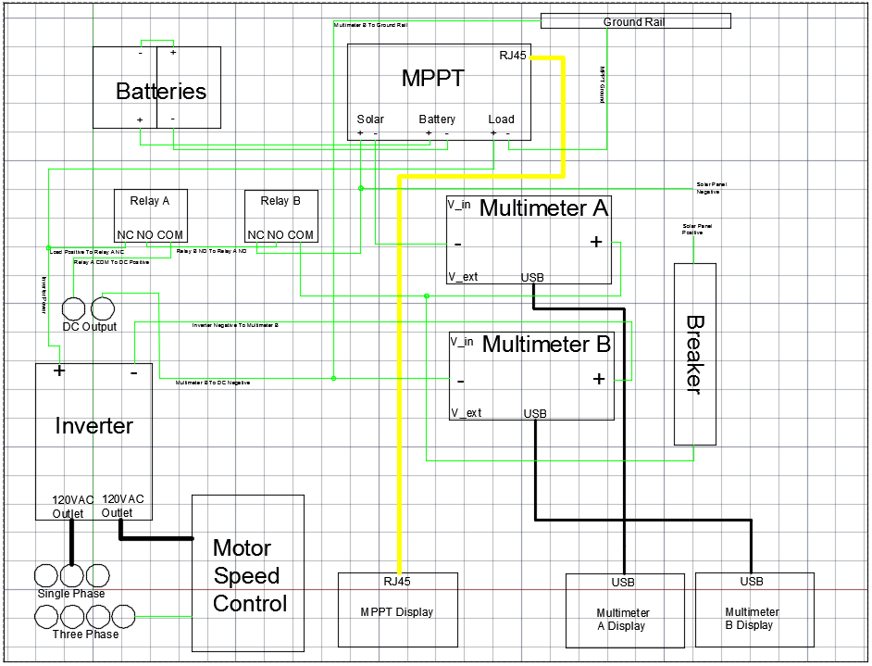
Functional Decomposition
Two 12V Batteries in Series: Functions as Power Storage
MPPT: Tracks the Max Power Point and Balances the Power Draw from the Solar Panel and Battery
Inverter: Converts DC to AC
VFD: Convert 1 Phase Power to 3 Phase, and Provides a Variable Frequency control
Relay 1: Provides Power to Displays
Relay 2: Connected Solar Power Input to DC Output or MPPT
Arduino: Takes in Readings from a Temperature sensor and Irradiance Sensor and Displays them
Multimeters: measure current and Voltages of Power Input and Load

Slide 15
Project cost
Resistor Bank- Various Resistors : $220.38
Enclosures: $92.66
Additional Components: $255.56
Design Cost: $568.60
Additional Batteries : $91.96
Additional Solar Panels: $700
Expansion Cost: $791.96
Overall Estimated Cost: $1360.56

Slide 16
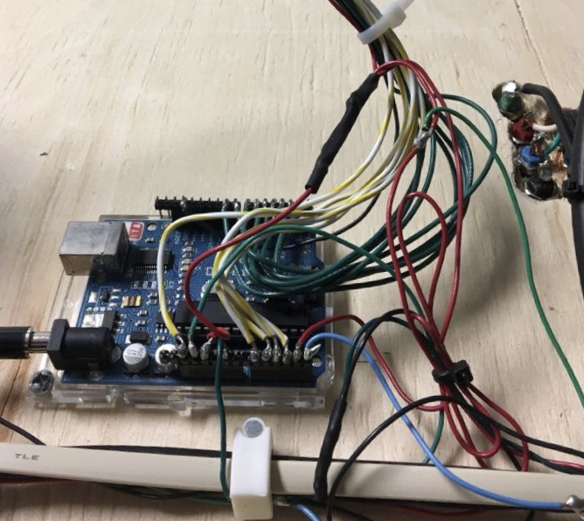
Hardware/software Platforms
Current setup includes an Arduino connected to the thermometer and pyranometer.
Used to store and display data using 2 libraries (GFX and TFTLCD).
Connected to a TFT LCD which displays the irradiance and temperature.
2 other displays are set up, receiving data from the multimeters.
They display Solar Panel characteristics and load characteristics for an AC load.
We will be adding in an additional display for the DC Load.

Slide 17
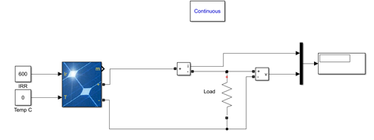
Testing
Setups tested in accurate Simulink models.
Max power point is the main measurement of interest.
Simulink allows easy variable and load changes.
Verified: With our new setup, our power will never exceed maximum ratings for any reasonable temperature or irradiance.

Slide 18
Responsibility of Each team Member
Drew Wassenaar – Team Lead
Chris Goodrich – Circuit Design Lead
Damon Stubbs – Software Lead
Kenny Nguyen – Webmaster/Circuit Design Engineer
Taylor Mullen – Testing Engineer

Slide 19
Thank you

Slide 20
Models and plots from Simulink
Varying Irradiance Varying Temperature

Slide 21
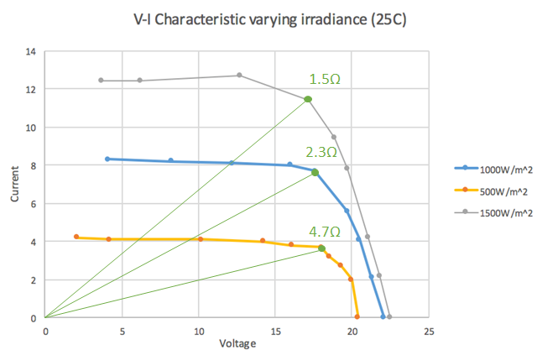
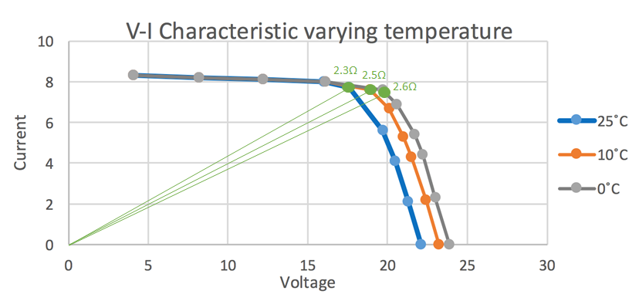
Simulink Continued

Slide 22
List of circuit components and limits
MPPT- 300 Watts
Inverter- 600 Watts
Battery- 12 Volts
Solar Panel Kyocera Model KD135GX-LPU- 135 Watts at 25 degrees C
Maximum power from solar panels- 270 Watts
Temperature Sensor N4c3xe-lm35dz LM35DZ

Slide 23
Solar Panel Name Plate

